Slide 1
Summary
I presented my new experiment design and my pilot data on sequential multi-option decision making. The underlying interest is during value comparison, people don’t simply register the value of each option and calculate a choice probability honestly according to their initial rating, instead, they do a pairwise comparison of values of the current option and the best seen option, and the winning option get a boost bonus in value and enters into the next rounds of competition. The pilot data shows a trend as in the simulated data.
Feedbacks from the lab meeting: I should incorporate the recency and primacy effect in my model. Try to run simulation under these models and formally compare whether we need the default bonus, recency bonus and the primacy bonus.
Also, I need to check whether there is a session related drift in my data, to see whether subject experience fatigue/boredom in the 3-hour experiment.

Slide 2
Decision-making under a sequential multiple-option choice frame
Chen Hu
(lab meeting 11/10/2017)

Slide 3
Introduction
Understand how options are compared during decision making process is crucial.
Former studies have identified that:
People’s prior preference can shift the value comparison frame. Choice are based on the value comparison between the default option vs the alternative (Lopez-Persem, eLife, 2016).
People’s preference might be shifted by their actions (e.g. choice). (Vinckier, submitted)
People demonstrate a bias towards the most recent presented options in sequential presentation (results reported by S. Ballesta in C. Padoa-Schioppa’s lab ; results in P. Domenech’s lab) .

Slide 4
Questions of interest
In sequential multiple-choice frame, is there a default option (temporary defied as the best option the subject encounters so far ) serve as the reference option?
Will there be interactions between option values and option sequences?
How potential pre-commitment might modify people’s preference and confidence report?

Slide 5
Hypothesis
In sequential multiple option choice, instead of registering the value of each option and compare them at the end step base on Softmax rule, people will implement the value comparison in multiple steps (i.e. for n items, do (n – 1) pairwise comparison).
Each time a new option emerges, people will compare the new option with the current best option. Whichever option wins will get a bonus of pre-committed (implicit, compare to explicit choice action), and enters into the next round with augmented value.
Therefore the final choice is based on the modified value after multiple pairwise comparisons instead of the initial reported ratings.
The same advantages are predicted by response time and confidence report.

Slide 6

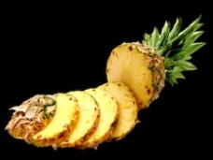
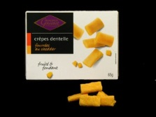








Task Structure
Practice
Rating
Practice
Choice
Cate1
Rating
Cate1
Choice
Cate2
Rating
Cate2
Choice
Cate3
Rating
Cate3
Choice
Cate4
Rating
Cate4
Choice
Cate5
Rating
Cate5
Choice
Per choice trial:
+ confidence
rating
Self-paced, > 500ms
1s
< 5s
Feedback 1s
In each blocks:
Ratings: 3*3 + 4*4 + 5*5 +6*6 = 86 items per block
Choice: 3 + 4 + 5 + 6 = 18 trials * 4 repetition = 72 per block

Slide 7
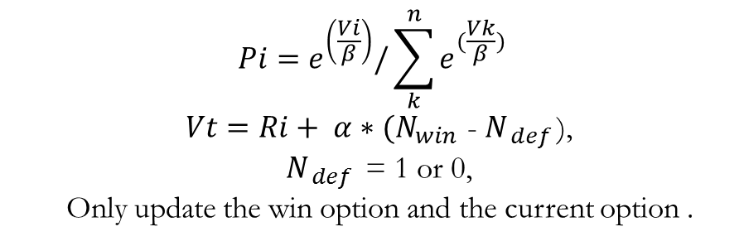
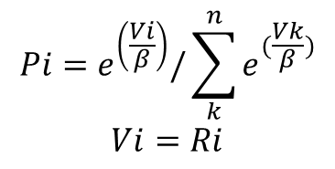
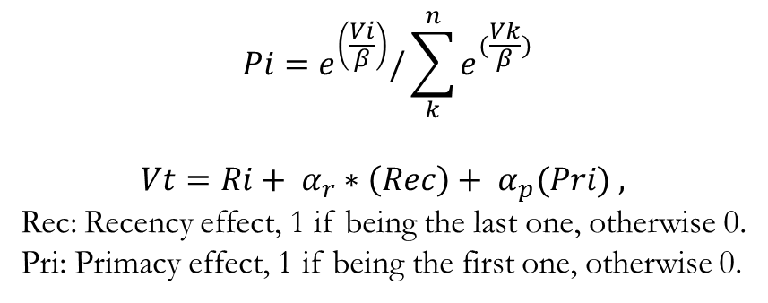
Hypothesis testing
$$Pi=e^{\left(\frac{Vi}{β}\right)}/\sum_{k}^{n}{e^{(\frac{Vk}{β})}}$$
$$Vi=Ri$$
H0
H1- default:
H2- recency and primacy effect :
$$Pi=e^{\left(\frac{Vi}{β}\right)}/\sum_{k}^{n}{e^{(\frac{Vk}{β})}}$$
$Vt=Ri+ α∗{(N}_{win }$- $N_{ def }$),
${ N}_{ def }$ = 1 or 0,
Only update the win option and the current option .
$$Pi=e^{\left(\frac{Vi}{β}\right)}/\sum_{k}^{n}{e^{(\frac{Vk}{β})}}$$
$$Vt=Ri+ α_{r}∗\left(Rec\right)+ α_{p}(Pri) ,$$
Rec: Recency effect, 1 if being the last one, otherwise 0.
Pri: Primacy effect, 1 if being the first one, otherwise 0.

Slide 8
Task simulation
Based on previous tasks using similar items, the ratings are simulated as uniformly distributed random integers from 0 to 100, with 10% attracted to the 0 point.
Result set: 86 ratings *10 categories, 18 trials* 10 categories (24 subjects)
Simulate the choice:
Using the inverse temperature from the previous study of DV on choice
Simulate a range of possible ‘bonus for winning a comparison’, ranging from 0.51 to 10,02), to verify the extent to which the predicted effects sustain.

Slide 9
Simulations choice under H0 and H1

Slide 10
H1 with primacy and recency bonus (beta = 0.51)

Slide 11
Pilot results: rating and confidence rating across categories

Slide 12
Pilot results: choice probability

Slide 13
Pilot results: response time

Slide 14
Pilot results: confidence

Slide 15
Pilot results: processing time

Slide 16
Regression coefficient

Slide 17
Discussion
Regarding the design:
whether we should mask the options?
Whether we should constraint a time out if no mask?
Alternative models proposal needed

Slide 18
New analysis

Slide 19
Pilot results: choice probability

Slide 20
Pilot results: response time

Slide 21
Pilot results: confidence

Slide 22
Effect size analysis
Beta_rt: t (10) = 1.93, if → 30, t(29) = 3.18, p = 0.002 ~ 0.01
Beta_conf: t (10) = 1.90, if → 30, t(29) = 3.14, p = 0.002 ~ 0.01
Beta_choice: t (10) = -1.07, if → 30, t(29) = 1.76, p = 0.05 ~ 0.1
if → 40, t(39) = 2.03, p = 0.025~0.5 , all two tails

Slide 23
Session drift effects

Slide 24
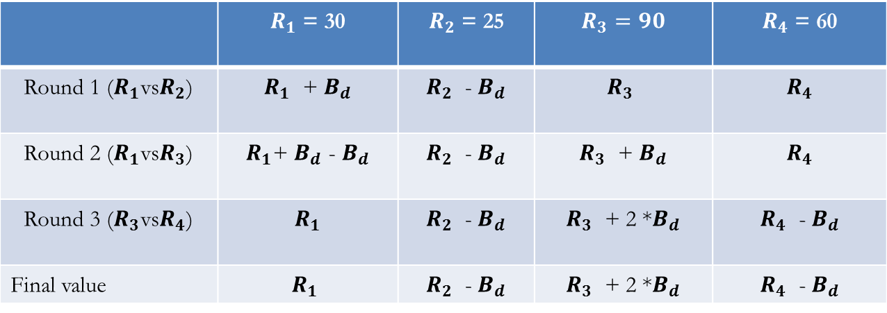
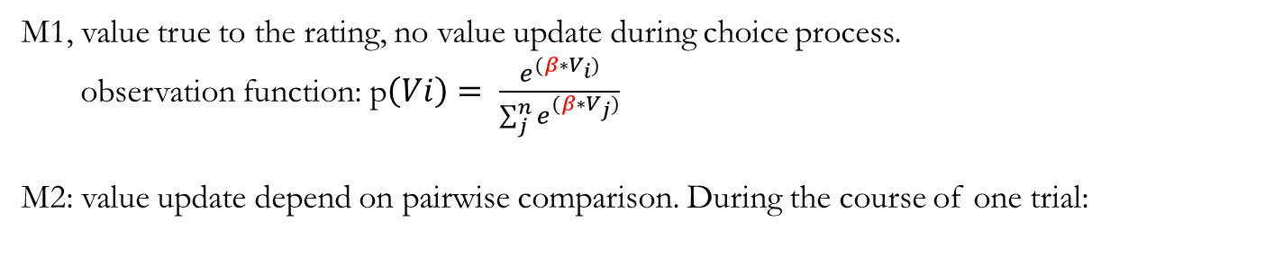
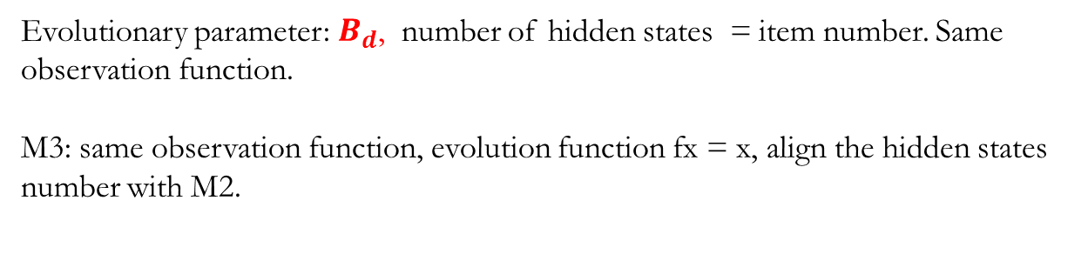
Model on choice
M1, value true to the rating, no value update during choice process.
observation function: p$\left(Vi\right)= \frac{e^{(β∗V_{i})}}{\sum_{j}^{n}{e^{(β∗V_{j})}}}$
M2: value update depend on pairwise comparison. During the course of one trial:
 | $R_{1}$ = 30 | $R_{2}$ = 25 | $$R_{3}=90$$ | $R_{4}$ = 60
Round 1 ($R_{1}$vs$R_{2}$) | $R_{1}$ + $B_{d}$ | $R_{2}$ - $B_{d}$ | $$R_{3}$$ | $$R_{4}$$
Round 2 ($R_{1}$vs$R_{3}$) | $R_{1}$+ $B_{d}$ - $B_{d}$ | $R_{2}$ - $B_{d}$ | $R_{3}$ + $B_{d}$ | $$R_{4}$$
Round 3 ($R_{3}$vs$R_{4}$) | $$R_{1}$$ | $R_{2}$ - $B_{d}$ | $R_{3}$ + 2 *$B_{d}$ | $R_{4}$ - $B_{d}$
Final value | $$R_{1}$$ | $R_{2}$ - $B_{d}$ | $R_{3}$ + 2 *$B_{d}$ | $R_{4}$ - $B_{d}$
Evolutionary parameter: $B_{d}$, number of hidden states = item number. Same observation function.
M3: same observation function, evolution function fx = x, align the hidden states number with M2.

Slide 25
Posterior on observation parameter – inverse temperature
Prior: 0.046, from last experiment with binary choices
M1: mean(obs_m1) = 0.08 M2: 0.0065 M3: 0.0062

Slide 26
Posterior on evolution parameter – winning bonus
N = 11
T-test against zero
t = 0.36 , p = 0.73, mean = 0.18
not significant
Power test, when n = 30, still not significantly different from zero.
When exclude the outliner = 5
N = 10, mean = - 0.30
t = - 2.62, p = 0.028 *

Slide 27
Posterior on hidden states

Slide 28
Model comparison results
Model comparison, m1, m2, m3, winning model = m1
Model comparison, m2, m3, winning model = m3

Slide 29
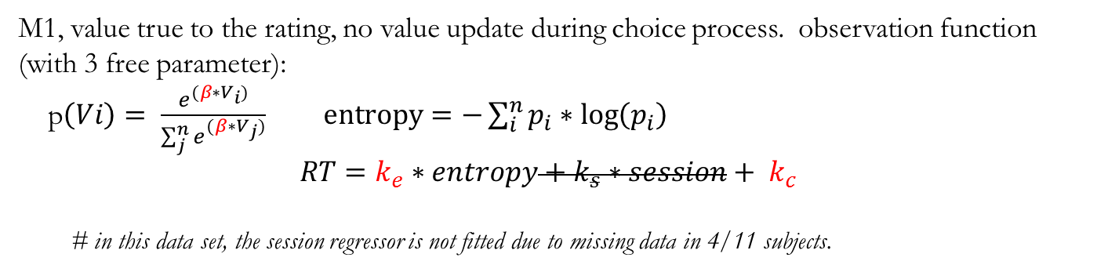
Model on Response Time
M1, value true to the rating, no value update during choice process. observation function (with 3 free parameter):
p$\left(Vi\right)= \frac{e^{(β∗V_{i})}}{\sum_{j}^{n}{e^{(β∗V_{j})}}} entropy=−\sum_{i}^{n}{p_{i}∗\log\left(p_{i}\right)}$
$$RT=k_{e}∗entropy+k_{s}∗session+ k_{c}$$
# in this data set, the session regressor is not fitted due to missing data in 4/11 subjects.
M2: value is updated as in the choice data, option get a winning bonus each time they win in a pairwise comparison, as proposed previously.
Evolution parameter = 1, same observation function as in M1 rt
Number of hidden states = Number of objects = 430
M3: value is not updated, there is an evolution function in which fx =x, no evolution parameters.
same observation function as in M1 RT
Number of hidden states = Number of objects = 430, but not updated

Slide 30
Posterior on observation parameters (inverse temp)

Slide 31
Posterior on observation parameters (weight on entropy)
M1 t= 1.426, p = 0.18. When n = 30, t = 2.34, p <0.05
M2 t= -3.32, p = 0.008.
M3 t= -3.12, p = 0.011.

Slide 32
Posterior on observation parameters (constant)

Slide 33
Posterior on evolution parameters
N = 11
T-test against zero
t = - 0.999 , p = 0.34, mean = -0.44
not significant
Power test,
when n = 30,
t = - 1.65, p = 0.11 (two side)
When n = 40,
t = - 1.91, p between 0.05 and 0.1, ns

Slide 34
Posterior on hidden states

Slide 35
Model comparison results
Model comparison, m1, m2, m3, winning model = m1
Model comparison, m2, m3, winning model = m3

Slide 36
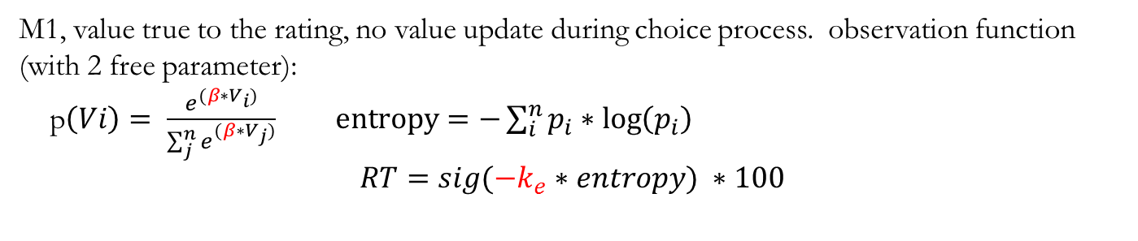
Model on confidence
M1, value true to the rating, no value update during choice process. observation function (with 2 free parameter):
p$\left(Vi\right)= \frac{e^{(β∗V_{i})}}{\sum_{j}^{n}{e^{(β∗V_{j})}}} entropy=−\sum_{i}^{n}{p_{i}∗\log\left(p_{i}\right)}$
$$RT={sig(−k}_{e}∗entropy) ∗100$$
M2: value is updated as in the choice data, option get a winning bonus each time they win in a pairwise comparison, as proposed previously.
Evolution parameter = 1, same observation function as in M1 confidence
Number of hidden states = Number of objects = 430
M3: value is not updated, there is an evolution function in which fx =x, no evolution parameters.
same observation function as in M1 confidence
Number of hidden states = Number of objects = 430, but not updated

Slide 37
Posterior on observation parameters (inverse temp)

Slide 38
Posterior on observation parameters (weight on entropy)
M1 t= 5.20, p < 0.001.
M2 t= 6.20, p < 0.001.
M3 t= 6.23, p < 0.001.

Slide 39
Posterior on evolution parameters
N = 11
T-test against zero
t = 1.21 , p = 0.26, mean = 2.87
not significant
Power test, when n = 30, p = 0.05
When exclude 1 extreme value
t = 1.13, p = 0.28, mean = 0.53
Will not be significant when n = 30, p between 0.05 and 0.1

Slide 40
Posterior on hidden states

Slide 41
Model comparison results
Model comparison, m1, m2, m3, winning model = m1
Model comparison, m2, m3, winning model = m3

Slide 42
New analysis Jan2018 – 23 subjects

Slide 43
Confidence rating across categories

Slide 44
RT & confidence
**
**
*
*

Slide 45
choice probability (n = 23)

Slide 46
Response time (n = 23)

Slide 47
Confidence (n = 23)

Slide 48
Processing time (n = 23)

Slide 49
regression analysis – rt choice conf to best option position
P = 0.103
P = 0.0487
P = 0.112

Slide 50
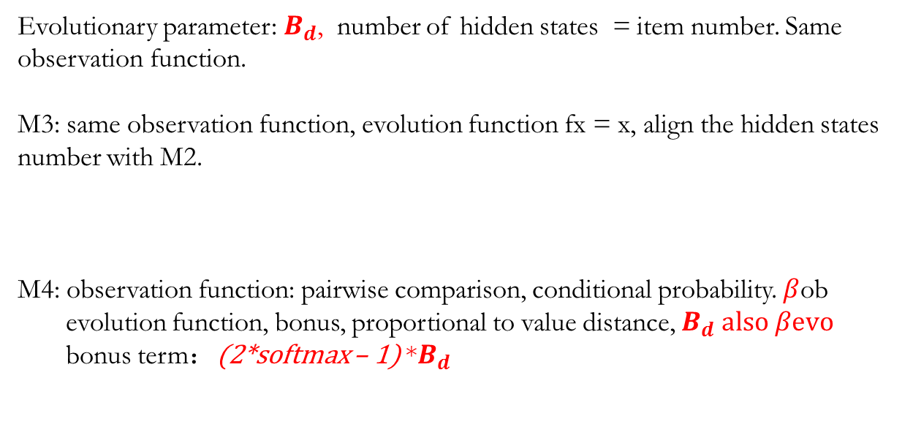
Model on choice
M1, value true to the rating, no value update during choice process.
observation function: p$\left(Vi\right)= \frac{e^{(β∗V_{i})}}{\sum_{j}^{n}{e^{(β∗V_{j})}}}$
M2: value update depend on pairwise comparison. During the course of one trial:
Evolutionary parameter: $B_{d}$, number of hidden states = item number. Same observation function.
M3: same observation function, evolution function fx = x, align the hidden states number with M2.
M4: observation function: pairwise comparison, conditional probability. $β$ob
evolution function, bonus, proportional to value distance, $B_{d} also β\text{evo}$
bonus term：(2*softmax – 1) *$B_{d}$

Slide 51
Posterior on observation parameter – inverse temperature
Prior: 0.046, from last experiment with binary choices

Slide 52
Posterior on evolution parameter (m2) – winning bonus
N = 23
T-test against zero
t = -0.31 , p = 0.76, mean = -0.08
not significant

Slide 53
Posterior on evolution parameter (m4)
N = 23
T-test against zero
t = 3.58 , p = 0.0017

Slide 54
Posterior on hidden states (m2)

Slide 55
Posterior on hidden states (m4)

Slide 56
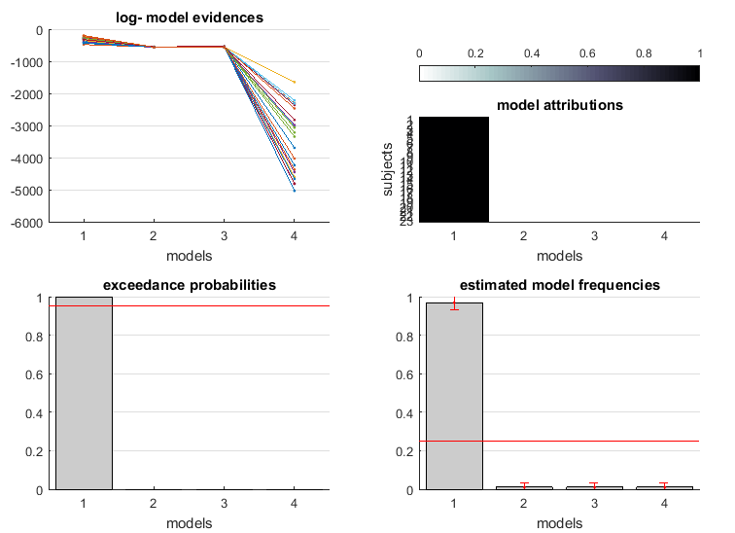
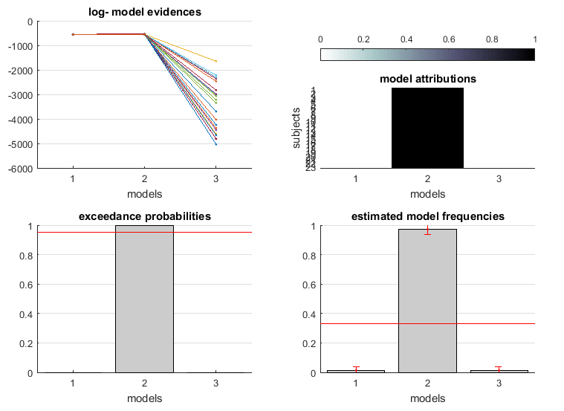
Model comparison results
Model comparison, m1, m2, m3, m4 winning model = m1
Model comparison m2, m3, m4 winning model = m3

Slide 57
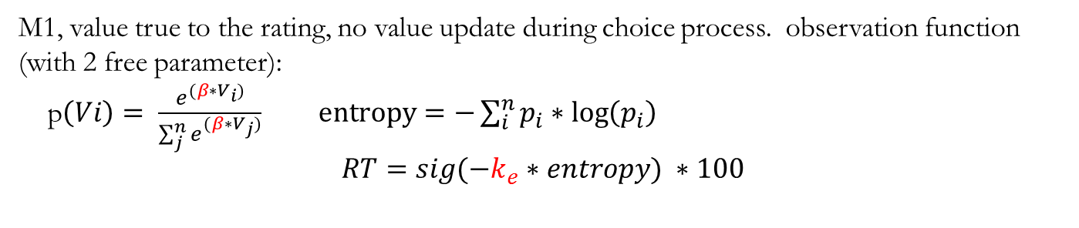
Model on confidence
M1, value true to the rating, no value update during choice process. observation function (with 2 free parameter):
p$\left(Vi\right)= \frac{e^{(β∗V_{i})}}{\sum_{j}^{n}{e^{(β∗V_{j})}}} entropy=−\sum_{i}^{n}{p_{i}∗\log\left(p_{i}\right)}$
$$RT={sig(−k}_{e}∗entropy) ∗100$$
M2: value is updated as in the choice data, option get a winning bonus each time they win in a pairwise comparison, as proposed previously.
No. Evolution parameter = 1, same observation function as in M1 confidence
Number of hidden states = Number of objects = 430
M3: value is not updated, there is an evolution function in which fx =x, no evolution parameters.
same observation function as in M1 confidence
Number of hidden states = Number of objects = 430, but not updated
M4: value is updated as in the choice data, option get a winning bonus proportional to their relative value (describe by a softmax function) each time they win in a pairwise comparison, as proposed previously.
No. Evolution parameter = 2, pairwise obersvation function

Slide 58
Posterior on observation parameters (inverse temp)

Slide 59
Posterior on observation parameters (weight on entropy)

Slide 60
Posterior on evolution parameters
N = 23
T-test against zero
t = 1.39 , p = 0.17, mean = 1.59
not significant

Slide 61
Posterior on hidden states (m2)

Slide 62
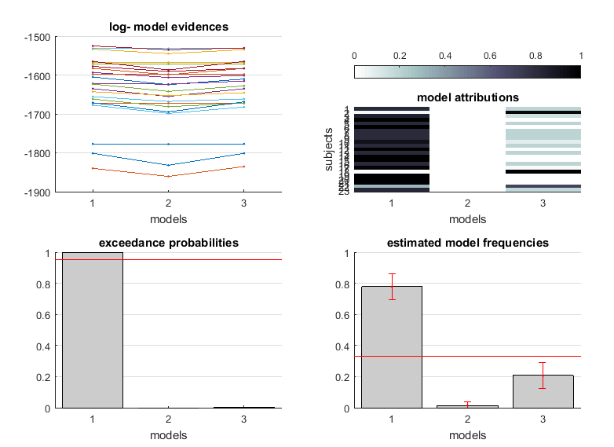
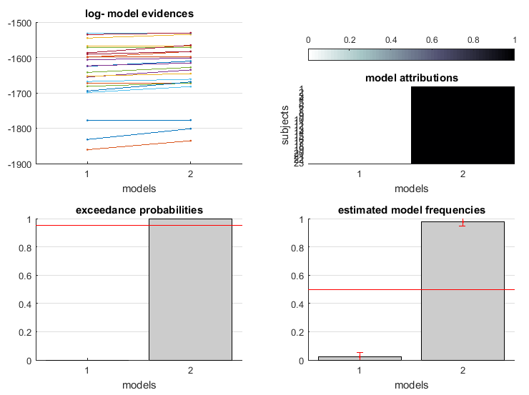
Model comparison results
Model comparison, m1, m2, m3
winning model = m1
Model comparison, m2, m3 winning model = m3

Slide 63

Model on Response Time
M1, value true to the rating, no value update during choice process. observation function (with 3 free parameter):
p$\left(Vi\right)= \frac{e^{(β∗V_{i})}}{\sum_{j}^{n}{e^{(β∗V_{j})}}} entropy=−\sum_{i}^{n}{p_{i}∗\log\left(p_{i}\right)}$
$$RT=k_{e}∗entropy+k_{s}∗session+ k_{c}$$
# in this data set, the session regressor is not fitted due to missing data in 4/11 subjects.
M2: value is updated as in the choice data, option get a winning bonus each time they win in a pairwise comparison, as proposed previously.
Evolution parameter = 1, same observation function as in M1 rt
Number of hidden states = Number of objects = 430
M3: value is not updated, there is an evolution function in which fx =x, no evolution parameters.
same observation function as in M1 RT
Number of hidden states = Number of objects = 430, but not updated
M4: value is updated as in the choice data, option get a winning bonus proportional to their relative value (describe by a softmax function) each time they win in a pairwise comparison, as proposed previously.
No. Evolution parameter = 2, pairwise obersvation function

Slide 64
Posterior on observation parameters (inverse temp)

Slide 65
Posterior on observation parameters (weight on entropy)

Slide 66
Posterior on observation parameters (constant)

Slide 67
Posterior on evolution parameters (m2)
N = 23
T-test against zero
t = - 0.98 , p = 0.34, mean = -0.32
not significant

Slide 68
Posterior on evolution parameters (m4)
N = 23
T-test against zero
t = - 0.70 , p = 0.49, mean = -0.31
not significant

Slide 69
Posterior on hidden states (m2)

Slide 70
Posterior on hidden states (m4)

Slide 71
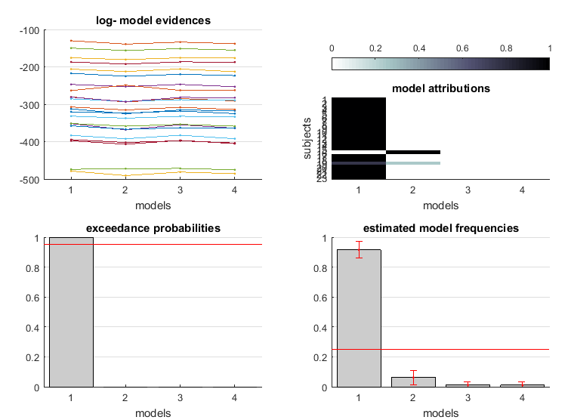
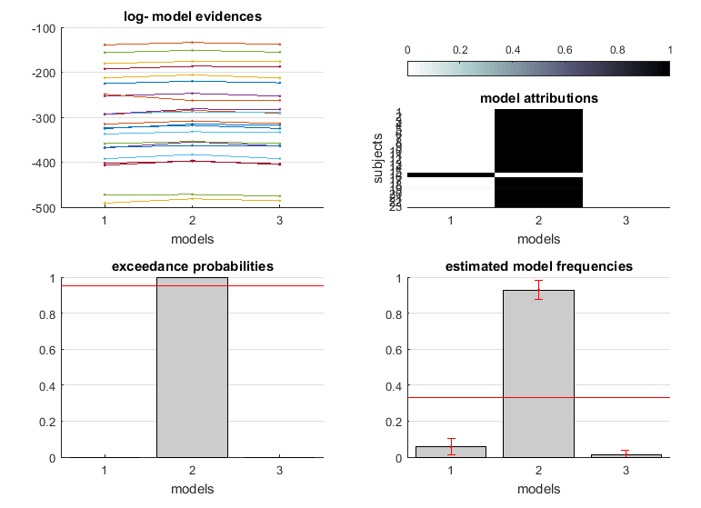
Model comparison results
Model comparison, m1, m2, m3, m4 winning model = m1
Model comparison, m2, m3, m4winning model = m3

